Slide 1
Data & ai Power BI use case
12 October 2020

Slide 2

USE CASE
Use of Power BI
Power Query
Add your data
Multiple data sources: Excel files, SQL Server database, CSV-files, …
Power Pivot:
Create a relational data model
Transform your date
Power View / MAP
Create visualizations
Learn about PowerBI

Slide 3
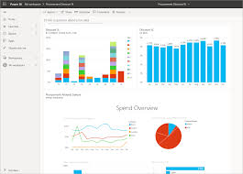
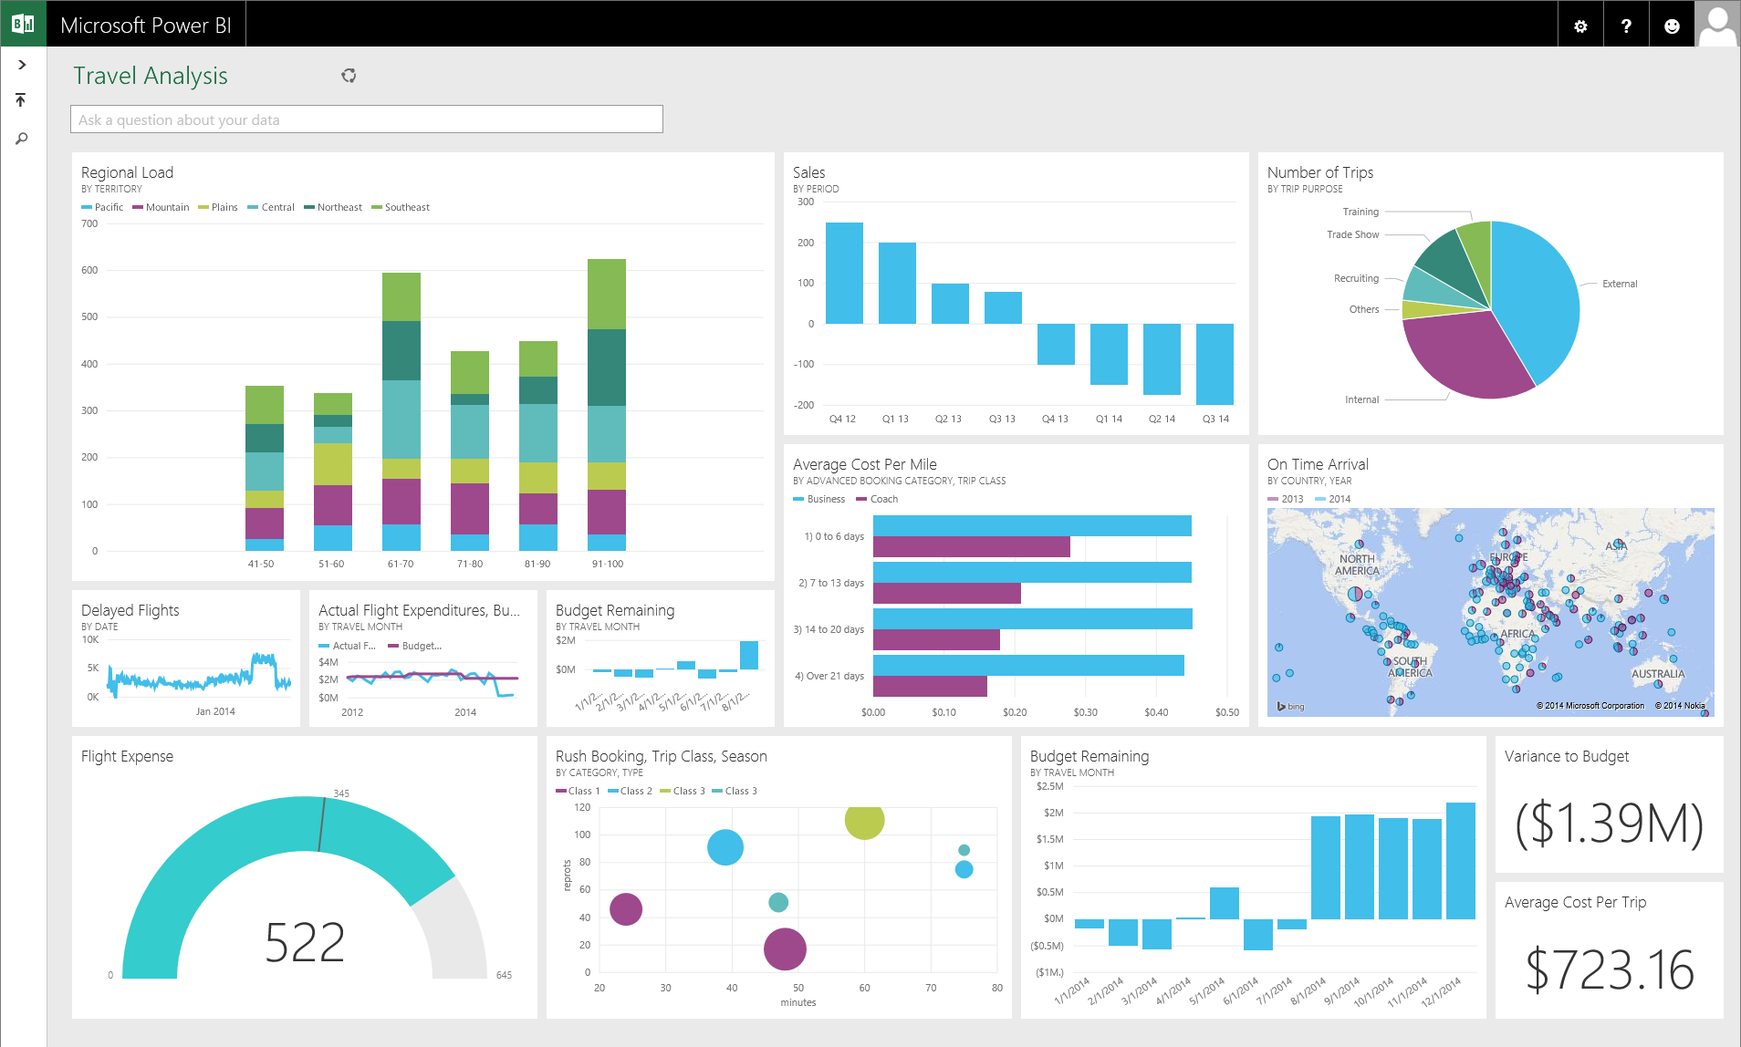
USE CASE
Different aspects
Understand the data & model
Insights? Use Case? (What? Who? Actions?)
Best visualization to present the data
User Friendly
Look & Feel
Extra: Visualize the data model

Slide 4
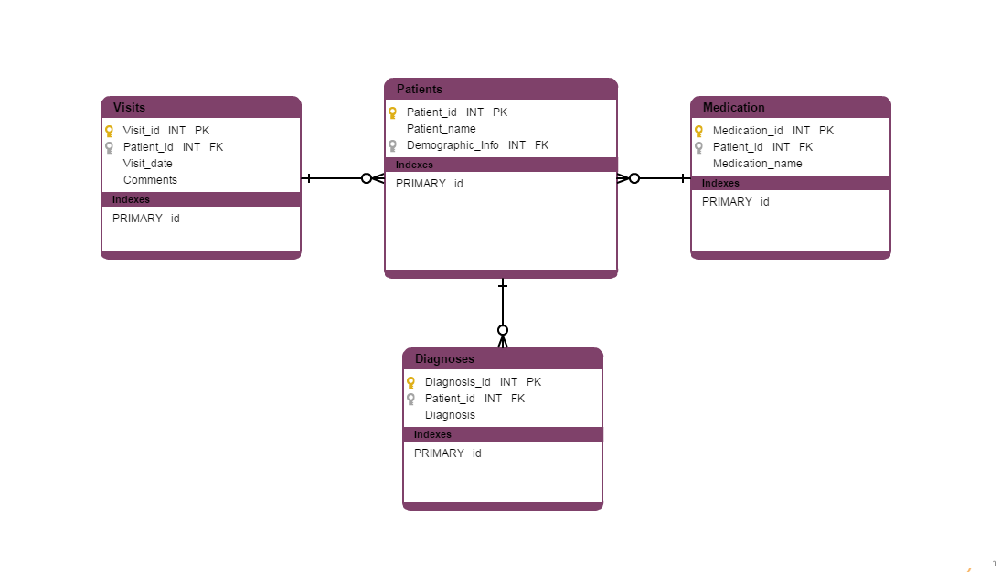
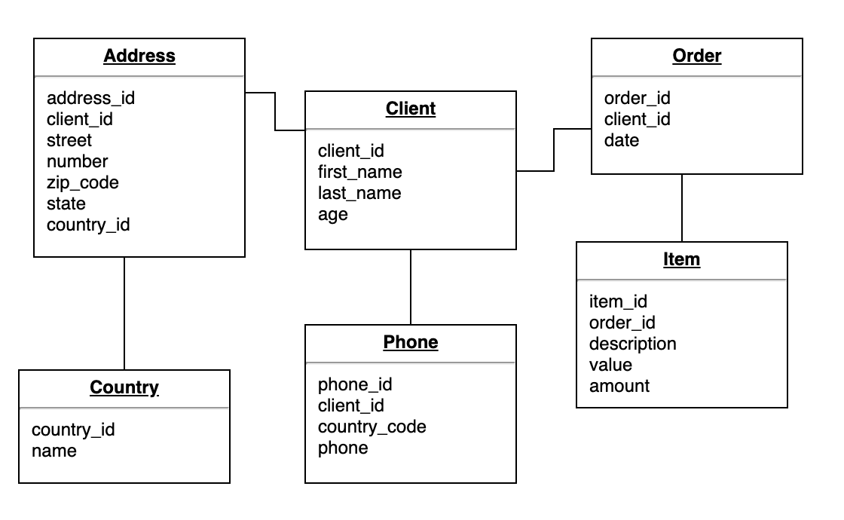
USE CASE
Visualize the data model
Relational data model
Primary and Foreign Key’s
Relations
Tools eg: Draw.io or Grafity

Slide 5
DATA
FOTG Data set
Customers
Customer ID - PK
Customer allergy
Customer ID - PK
Allergy ID - PK
Allergies
Allergies ID - PK
Order: One order can exist of multiple Order Items (Eg ordering 2 Margherita pizza’s and 1 garlic bread)
Order ID – PK
Customer ID – FK
Restaurant ID – FK
Order Item: The individual items per order, in example above 2 times the Margherita pizza and 1 time the garlic bread)
Order Item ID – PK
Order ID – FK
Order Table ID – FK
Order Table: The items that can be ordered (menu card), unique list of all the items per restaurant, including the name of the item and the price
Order Table ID - PK
Restaurant:
Restaurant ID - PK

Slide 6
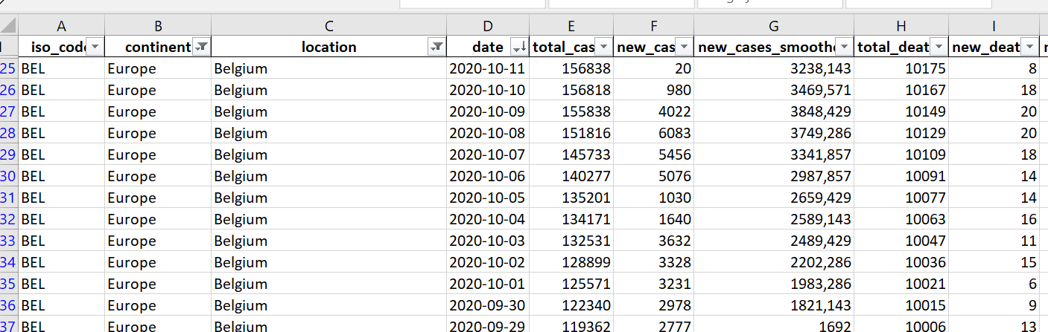
DATA
Online available Corona datasets
https://ourworldindata.org/coronavirus-source-data
Download excel or csv

